Slide 1
Competitive brain and body growth model
Predator Prey Team and Wolfram Solutions

Slide 2
Background and motivation
With sufficient nutrient intake, normal human development can support growth of body and brain along natural growth curves that vary from individual to individual.
However, when nutrient intake is limited, these distinct development needs must compete for scarce energy resources, imposing a tradeoff between full brain and full body development for a given age.
We propose a mathematical model that links the daily nutrient intakes to brain and body development. The model characterizes normative infant growth curves and is able to simulate different scenarios like regular feeding, catch-up growth and under- and over-nutrition based on changes in nutritional intake. Available energy generated from varied nutrient intake are assigned to different reservoirs.

Slide 3
Competitive Brain and Body growth model
DAILY GROWTH SCHEME
Individual state
day N
Daily growth function
Individual state
day N+1
Nutrient intake
day N
Global parameters
The competitive brain and body growth model computes a growth trajectory of a single subject taking into account his daily nutrient intakes. The model is a recursion of a daily growth function, which takes as input the individual state for a particular day and the nutrient intakes and it returns the new individual state for the next day.
The model spans from 0 to 5 years.

Slide 4
nutrient intake 100% of requirement
Reservoir | kcal
Brain maintenance | 116
Body maintenance | 414
Brain development | 168
Body development | 17
Physical activities | 82
Caloric requirement function
Caloric requirement:
889 kcal
Individual state
day N
Reservoir | kcal
Brain maintenance | 116
Body maintenance | 414
Brain development | 168
Body development | 17
Physical activities | 82
Nutrient intake
day N
889 kcal
Energy partition function
Total energy repartition
Reservoir | gr
Fat body mass | 1.2
Lean body mass | 6.3
Brain weight | 1.6
Updated body measures
Individual state
day N+1

Slide 5
Nutrient intake 90% of requirement
Reservoir | kcal
Brain maintenance | 116
Body maintenance | 414
Brain development | 168
Body development | 17
Physical activities | 82
Caloric requirement function
Caloric requirement
889 kcal
Individual state
day N
Nutrient intake
day N
800 kcal
Energy from body mass
Reservoir | kcal
Brain maintenance | 116
Body maintenance | 410
Brain development | 166
Body development | 15.8
Physical activities | 81
Nutrient intake + fat energy
870 kcal
Energy partition function
Total energy
repartition
Reservoir | gr
Fat body mass | -5.3
Lean body mass | 6.2
Brain weight | 1.6
Updated body measures
Individual state
day N+1

Slide 6
Energy Competition
Available energy generated from varied nutrient intake are assigned to different reservoirs (brain maintenance and its development, body maintenance and its development and physical activity).
In case of underfeeding and malnutrition, these reservoirs will compete for the caloric resources.

Slide 7
Model Results
We first successfully characterized the normative growth curves associated with each percentile “growth channel” of the WHO standard growth curves.
Several anthropometry data are tracked down.

Slide 8
Model Results

Slide 9
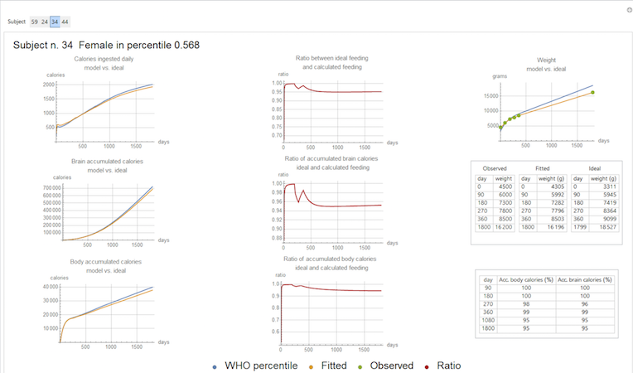
Fitting data
We used the model to estimate the daily nutrient intakes for the first 5 years of a longitudinal Guatemala study (N =92).

Slide 10
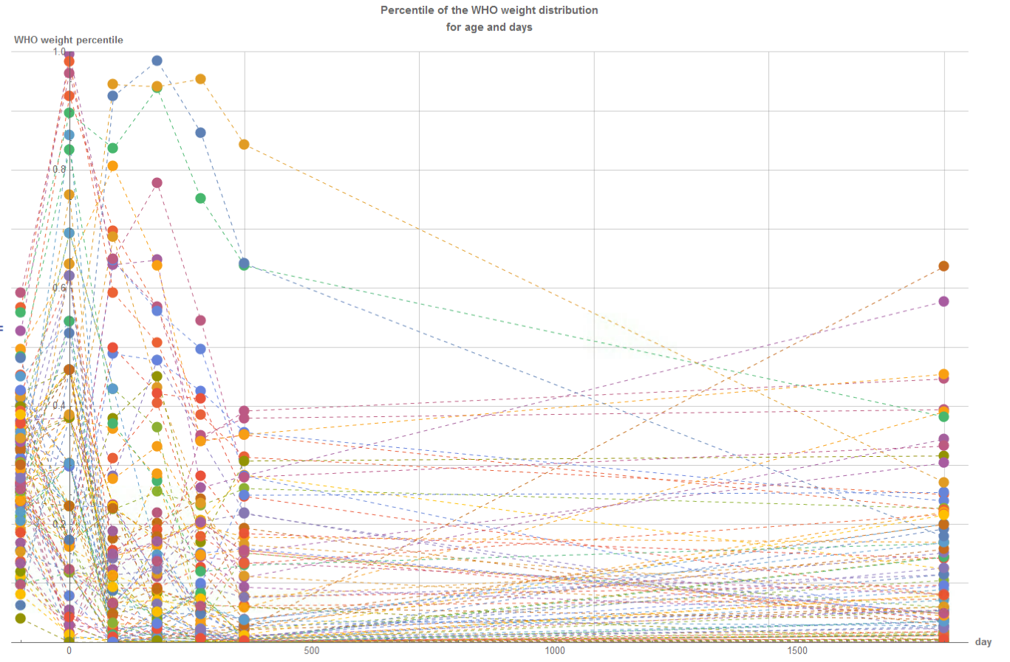
WHO Curves Percentile mobility
We can look at how, over time, the percentile an individual is in changes. The first column of dots refers to the computed percentile, while the following are calculated WHO percentiles:

Slide 11
Further Directions
The competitive brain and body growth model can be extended to the gestational period.

